Slide 1



MEASUREMENT OF COMPETITION LEVEL ANXIETY OF COLLEGE LEVEL ATHLETES BY USING SCAT
MEASUREMENT OF COMPETITION LEVEL ANXIETY OF COLLEGE LEVEL ATHLETES BY USING SCAT
Dr. Subhabrata Kar
Assistant Professor,
Department of Physical Education,
Union Christian Training College,
Berhampore, Murshidabad, W.B.
Dr. Subhabrata Kar
Assistant Professor, Department of Physical Education,
Union Christian Training College,
Berhampore, Murshidabad, W.B.

Slide 2
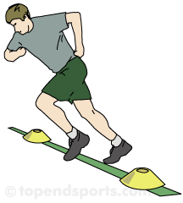
INTRODUCTION
All athletes experience the anxious thoughts that so frequently occur in response to stress. Throughout the course of one’s career, however, the sources of stress and the kinds of anxious thoughts experienced change. The increased stress of competitions can cause athletes to react both physically and mentally in a manner which can negatively affect their performance abilities.
Sports and performance anxiety often go hand-in-hand. While many athletes become "pumped up" during competition, when the rush of adrenaline is interpreted as anxiety, and negative thoughts begin to swirl, it can have devastating effects on his/her ability to perform. Before an athlete learns how to manage the symptoms of anxiety during competitions, it is important to understand the relationship between anxiety and athletic performance.

Slide 3
METHODS
SUBJECTS:
55 male and female college going track and field athletes were selected from 120 population of Nadia & Murshidabad district of West Bengal of age group 22-25. The athletes had an average of 3 years participation experience in district, state or university level track & field competitions. Among the 55 athletes 20 were sprinters and jumpers or both (SJG), which consisted with 12 male and 8 female athletes; 20 were long distance runners (LDG), which consisted with 12 male and 8 female athletes and 15 were middle distance runners (MDG), which consisted with 10 male and five female athletes.

Slide 4
PROCEDURE
To measure competition related anxiety of the athletes Sport Competition Anxiety Test (SCAT, developed by Rainer Martens in 1977) was introduced. Then each athlete’s composite score (CS) was found. Then that score was analysed according to SCAT score analysis norms. All 55 athletes were first of all provided with following SCAT questionnaire and they were asked to give their opinion strictly independent manner. The SCAT contains 15 items, 10 of which measures symptoms associated with anxiety. The five items that are not scored are included in the inventory to reduce the likelihood of an internal response-set bias. The standard instructions of the SCAT ask respondents to indicate how they “usually feel when competing in track & field competition”. Subjects were also asked to mention their events and number of participating years & level of competition.

Slide 5
SPORT COMPETITION ANXIETY TEST:
Assess how you feel about the following situations when you compete in Track & Field, using the following scale:
Hardly ever A
Sometimes B
Often C
1. Competing against others is socially enjoyable. ______
2. Before I compete, I feel uneasy. ______
3. Before I compete, I worry about not performing well. ______
4. I am a good sport person when I compete. ______
5. When I compete, I worry about making mistakes. ______
6. Before I compete I am calm. ______
______

Slide 6
7. Setting a goal is important when competing. ______
8. Before I compete I get a queasy feeling in my stomach. ______
9. Just before competing, I notice that my heart beats than usual. ______
10. I like to compete in games that demand considerable physical energy .______
11. Before I compete I feel relaxed. ______
12. Before I compete I am nervous. ______
13. Team sports are more exciting than individual sports.

Slide 7
14. I get nervous wanting to start the game. ______
15. Before I compete I usually get uptight. ______
SCORING
Items 1, 4, 7, 10, and 13 are filler items used to help disguise the purpose of the test; one should have to cross them our, as they will not be used for scoring. Items 2, 3, 5, 8, 9, 12, and 15 are scored in the following manner: hardly ever=1 pt., sometimes=2 pts, often=3 pts. For items 6 and 11, the scoring is reversed: hardly ever=3 pts, sometimes=2 pts, often=1 pt. Simply total the numbers for these 1- items to determine your trait anxiety score, which ranges from a low of 10, to a high of 30.

Slide 8
RESULTS
The results were prepared mainly according to Mean Composite Score (MCS) of three groups and ANOVA. All the means, S.D. and range of scores were presented in Table No. 1, 2 and 3.

Slide 9
Table No.-1 Mean and S.D. of SJG
Group | Mean | S.D. | Range
SJG | 21.78 | 2.643 | 8
SJG Female | 22.875 | 1.832 | 5
SJG Male | 21.983 | 2.75 | 8
Table No.-2 Mean and S.D. of MDG
Group | Mean | S.D. | Range
MDG | 23.00 | 2.643 | 7
MDG Female | 25.00 | 1.832 | 2
MDG Male | 22.00 | 2.75 | 6
Table No.-3 Mean and S.D. of LDG
Group | Mean | S.D. | Range
LDG | 16.95 | 1.5644 | 6
LDG Female | 17.87 | 1.7633 | 5
LDG Male | 16.33 | 1.027 | 3

Slide 10
Table No.-4 ANOVA Table for Comparison between means
Source | SS | df | MS | F | p
Treatment (Between) | 378.5773 | 2 | 189.2886 | 38.43* | <0.0001
Error | 256.15 | 52 | 4.926
Total | 634.7273 | 54
*Significant (0.01 level)
Table No.-5 Tukey Post Hoc Test
M_{1 Vs} M₂ | Not Sign. | M ₁ = Mean of SJG M ₂ = Mean of MDG M ₃= Mean of LDG | MSD = the absolute [unsigned] diff. between sample means required for significant at the designated level. HSD [0.05] for 0.05 level; HSD [0.01] for the 0.01 level.
M_{1 Vs} M₃ | P<0.01
M_{2 Vs} M₃ | P<0.01

Slide 11
Fig No.1 Mean Score of SJG.
Fig No.-2 Percentage of athletes in different levels of anxiety of SJG.

Slide 12
Fig No.3 Mean Scores of MDG.
Fig No.-4 Percentage of athletes in different levels of anxiety of MDG.

Slide 13
Fig No.5 Mean Scores of LDG.
Fig No.-6 Percentage of athletes in different levels of anxiety of LDG.

Slide 14
Fig No.-7 Percentage of athletes in different levels of anxiety for all three Groups
Fig. No.-8 Male & Female score comparison of three groups.

Slide 15
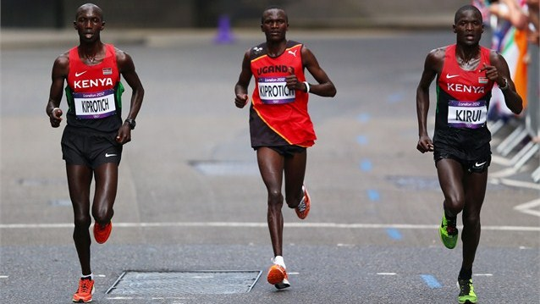
Fig.No.-10 Years of Participation of three groups.

Slide 16
DISCUSSION:
While considering MCS, SJG showed average level of competition anxiety (CA) with mean & SD as 21.748±2.643 where female sprinters showed on average high CA in comparison to boys.
In case of MDG, the overall mean CA level was found average (23±2.221), but girls showed high level of CA (25±0.632) in comparison to all groups.
On other hand, LDG showed, on average, low level of CA, i.e. overall mean and SD as 16.95±1.564.
In all thee cases female showed high level of competition anxiety than male.

Slide 17
One way ANOVA (Table No.-4) showed significant difference between three groups in respect of SCAT composite score of the subjects of three groups.
Post hoc test showed no significant difference between SJG and MDG. But significant difference found between SJG and LDG, as well as MDG and LDG.

Slide 18
The SJG showed that among 20 subjects 85% had average level of CA, 15 had high level of CA, but no person with low level of CA. On the other hand, MDG showed 67% of average, 33% of high and 0% of low level of CA. At the same time, LDG showed 50% 0f average, 50% of low and no high level of CA (Fig. No.-2,4 &6).
Result showed that number of subjects, who participated Track & field sports more than 4 years was more in LDG than other two groups (Fig. No.-10).
While taking three groups together, 67% found average, 18% found low and 15% found high level of CA (Fig.No.-7). Fig. No.-5 shows comparison between overall means of three groups and Fig. No.-9 shows male and female comparison of three groups.

Slide 19
CONCLUSION:
In the present study SCAT was used to find out the anxiety level of college athletes in inter-collegiate and university level track and field competitions.
The long distance runners showed low level of CA in comparison to sprint-jumping and middle-distance athletes.
In respect of competition level anxiety score long-distance runners are different from sprint-runners and middle-distance runners.
All three groups showed that female athletes have high level of CA than their male counterpart.
It may be concluded that the anxiety level of athletes is increased with level of participation as well as decreased with increment of participation year in sports.

Slide 20

THANKS
for your patience

