Slide 1
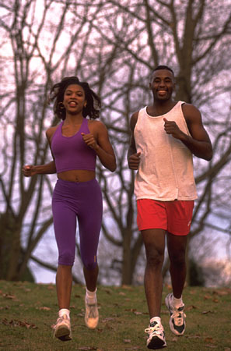

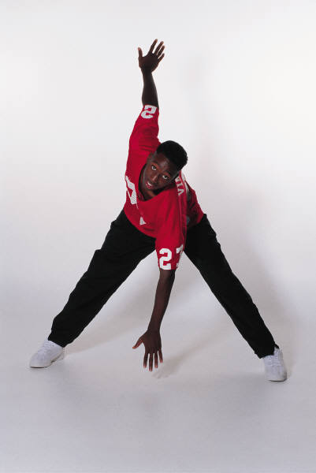
Exercise therapy
Dr. Kishore Mukhopadhyay
Assistant Professor,
Department of Physical Education,
Union Christian Training College,
Berhampore, Murshidabad, W.B.

Slide 2
Exercise
Exercise is a stressor which upsets the consistency of our internal environment
Therapy
Therapy means any method or procedure to alleviate any pathological condition affected by injury, disease or disorder. Pathological condition is a condition different from normal condition.
Exercise Therapy
When exercise is used for diagnostic, treatment, rehabilitation and after care purpose is termed as exercise therapy

Slide 3
Guiding principles in administering therapeutic exercises :
Assessing the condition of the person (prevention, cure or rehabilitation)
The exercise must be suitable, simple and in progressive order (simple to complex)
Exercise should be done slowly and within possible range.
There should be live demonstration or through pictures and charts.
Importance of the exercise should be impressed upon the patient. (written form prescription)
Mental and emotional state should be considered
Incentive may be offered where necessary

Slide 4

Do not allow to substitute the muscle group
Variety of activities with different types of movements be given
Static type activities be avoided
Regularity of exercise must be maintained

Slide 5
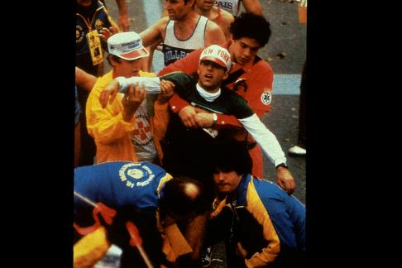
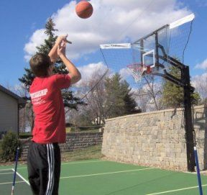
Exercise prescription doesn’t work without counseling the behavior!

Slide 6
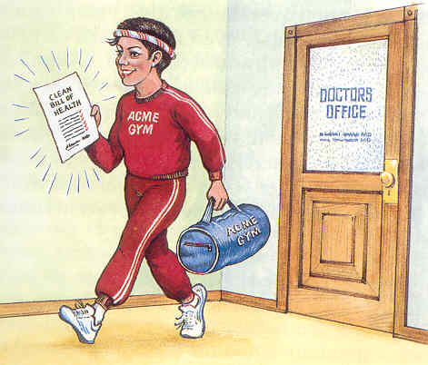
Benefits of exercise
Lifetime health and fitness benefits
  Increase in high density lipoproteins
  Decrease in triglycerides
  Improved lung function
  Helps reduce blood pressure, anxiety and depression
  Control weight
  Increase the body’s ability to dissolve blood clots by increasing fibrinolytic activity
  Helps the bones to be stronger – inhibiting osteoporosis
  Offers protection against diabetes and cancer

Slide 7
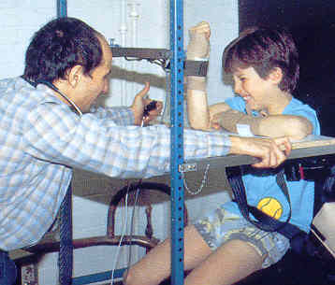
Concepts in Exercises:
Overload Principle:
  Greater stress must be applied than that to which an organism or tissue is accustomed in order to have adaptation take place
  Strengthening program must tax muscle groups towards it maximal capacity and beyond its usual functional capacity
  To increase strength, a load that exceeds the metabolic capacity of the muscle must be used during exercise, this will lead to hypertrophy and recruitment resulting in increase in strength

Slide 8
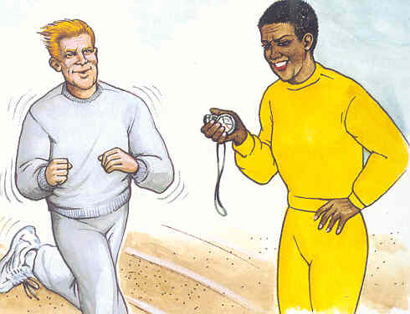
Concepts in exercise
Adaptation
  Cardiovascular system and muscles adapt to the training stimulus over time
  Significant changes noted in 10 – 12 weeks
  The higher the initial level of fitness, the greater the intensity of exercise needed to elicit a significant change

Slide 9

Effects of exercises
Acute or immediate effects
Chronic, adaptive or training effects
Local effects
Systemic effects

Slide 10
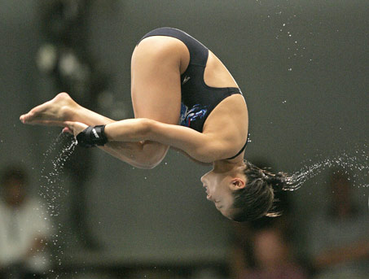
Acute Effects
Start of exercise:
increase heart rate
increase cardiac output
Increase in blood pressure
increase in venous return
increase in arterio- venous O2 difference

Slide 11
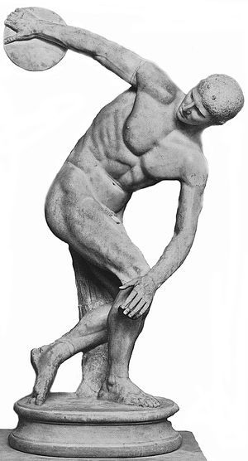
Systemic effects
In isotonic exercises
  decrease peripheral vascular resistance
  increase in muscle blood flow
In isometric exercises
  Decrease in local blood flow to the contracting muscles
  Increased blood pressure

Slide 12
Systemic effects
As exercise continues at constant rate:
  Steady State: heart rate
  Blood pressure
  Cardiac output
At the end of exercise:
  Initial rapid drop in heart rate then slower return to normal
  Decrease in blood pressure sudden if exercise is stopped abruptly

Slide 13
Systemic effects
respiratory effects:
  Respiratory rate increases: 5 – 6 times in maximal exercise
  Tidal volume increases: 5 – 7 times
Hormonal effects:
  Decrease insulin production
  Increase glycogen production
  Increased catecholamine, in intense exercises
  Increase in growth, adrenocorticotrophic, TSH, adrenal and androgens

Slide 14
Systemic effects
Arm exercises vs. leg exercises:
  Higher systolic and diastolic blood pressure
  Higher heart rate
  Higher oxygen uptake
Exercise should use workload 40 – 60 % lower than those used for LE in order to obtain systemic effects

Slide 15
Local effects
In the muscles being exerted:
  Increased oxygen extraction
  Increased oxygen consumption
  Increased carbon dioxide production
  vasodilatation

Slide 16
Local effects
During isometric contraction:
  Complete occlusion of blood flow
  70% of maximal voluntary contraction level
  Depletion of energy substrates
During isotonic exercise:
  Slow twitch fibers first to lose glycogen then followed by the fast twitch fibers

Slide 17

Parameters of exercise
Mode of exercise:
  Aerobic vs. anaerobic exercise
Intensity of exercise
Duration of exercise
Frequency of exercise

Slide 18
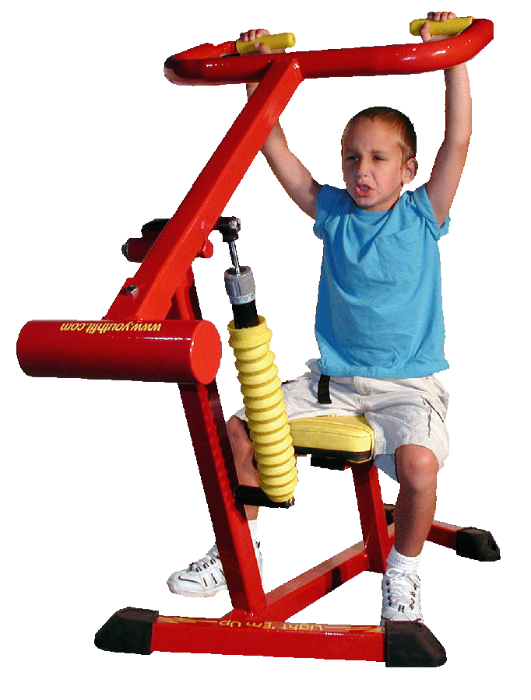
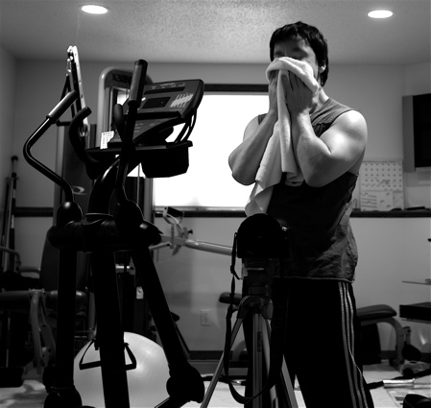
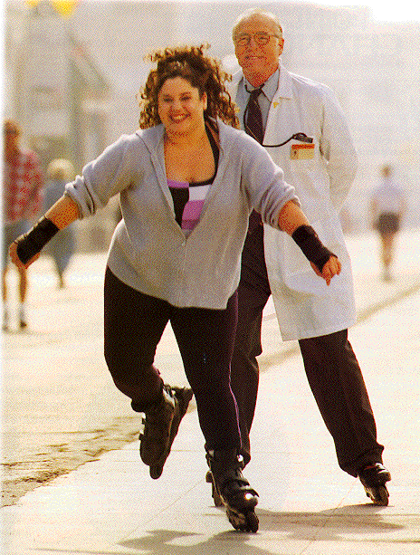
Overview
Shifting the Paradigm:
Exercise
Activity
  Exercise = Training
  Activity = Play, Fun, Functional Fitness
Notes:
18
Should be a routine part of well child care

Slide 19
The Exercise (Activity) Prescription
Mode
Duration
Frequency
Intensity
Timely Follow Up/ Progression
Therapy (Preventive and/or Therapeutic)
The “MD FITT” Prescription

Slide 20
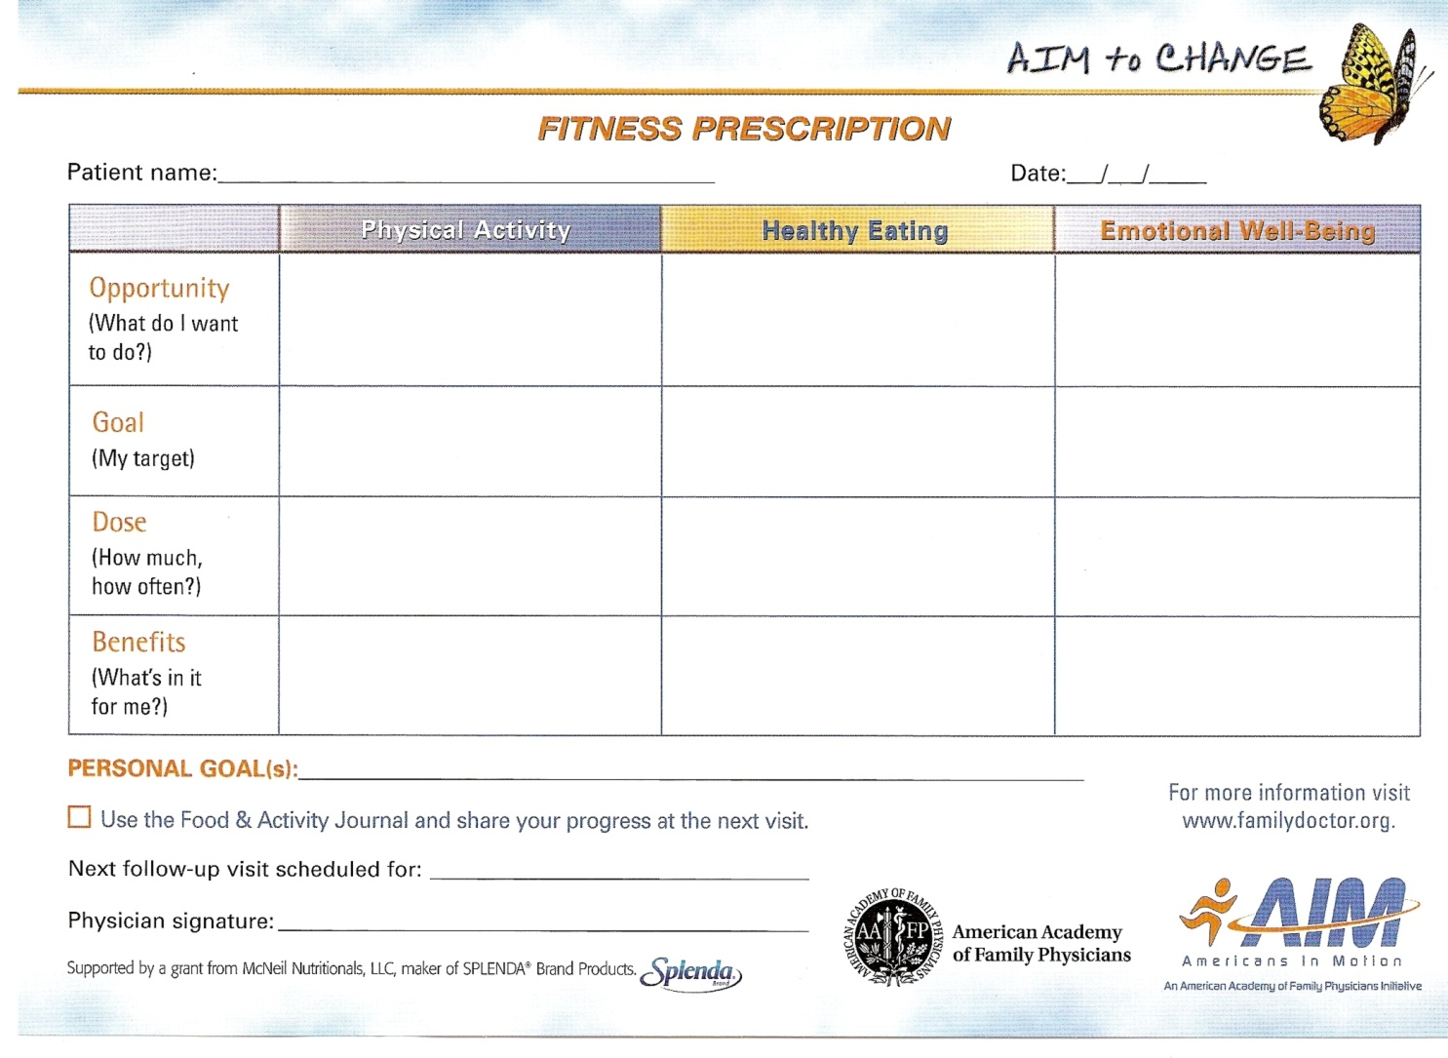
The Exercise (Activity) Prescription
The AIM Fitness Prescription
Mode
Duration + Frequency + Intensity
Paradigm:
Kids: Activity
Adults: Fitness
Older Adults: Functional Fitness
Timely Follow-up

Slide 21
COMPONENTS OF EXERCISE
PRE EXERCISE WARM UP
PRE-EXERCISE STRETCHING
EXERCISE PROPER
POST EXERCISE COLD DOWN
POST EXERCISE STRETCHING

Slide 22
PURPOSE OF WARM UP
to raise the general body temperature
to raise the deep muscle temperature - contracts more forcefully and relaxes more quickly
to stretch collagenous tissue
to reduce muscle viscosity, improving the mechanical efficiency
to increase the speed of nerve impulses and augment the sensitivity of the nerve receptors
to improve the cardiovascular response to sudden exercise

Slide 23
TYPES OF WARM UP
RELATED WARM UP
  when the specific skills of an event are performed during the warm up
  preferred if activity starts slowly and progresses into more intense activity
UNRELATED WARM UP
  when movements performed are different from the actual skills of the activity or event
  preferred if immediate participation in the actual activity is required

Slide 24
WARM UPS
15 - 20 minutes
intensity and duration should be individualized
enough to increase body temperature and perspire, not too intense to cause fatigue
usually coupled with few minutes of high intensity exercise to result in better performance

Slide 25
Warm up
the effects of warm up last up to 45 minutes
the closer the warm up to the event, the more beneficial it will be in terms of effective performance
should begin to taper off 10 - 15 minutes prior to the training or competition/ event
should end 5 minutes before the start of activity - to allow recovery from fatigue

Slide 26
STRETCHING
GOAL: to improve the range of motion at a given articulation by altering the extensibility of the musculotendinous units that produces the movements

Slide 27
TYPES OF STRETCHING
BALLISTIC STRETCHING
STATIC STRETCHING
PNF STRETCHING
PASSIVE STRETCHING
ACTIVE STRETCHING

Slide 28
BALLISTIC STRETCHING
requires repetitive contraction of the agonist muscle to produce quick stretches of the antagonist muscles
ADV: simulate sports specific skills - functional

Slide 29
STATIC STRETCHING
passive or active stretching a given antagonist muscle by placing it in a maximal position of stretch and hold it for an extended time
3 seconds to 60 seconds
three to four times

Slide 30
PNF STRETCHING
AKA: muscle energy release technique
techniques:
  contract - relax
  contract - relax - contract
commonly used with athletes and individuals with limited range of motion

Slide 31
TYPES OF STRENGTHENING EXERCISE
ISOMETRIC EXERCISES
ISOTONIC EXERCISES
ISOKINETIC EXERCISES

Slide 32
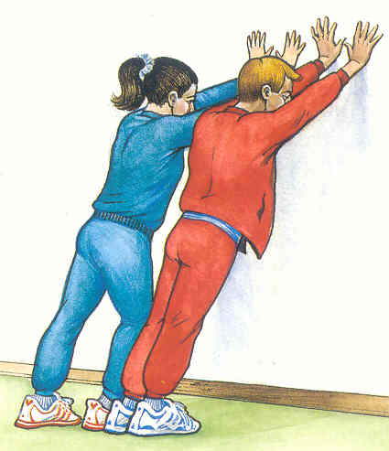
Types of exercise
Isometric exercise:
  Static exercise with muscle contraction but no movement of the load resulting in no change in the total length of the muscle

Slide 33
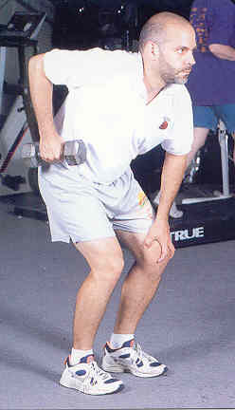
Type of exercise
Isotonic exercise:
  Dynamic exercise with a constant load but uncontrolled speed of movement

Slide 34
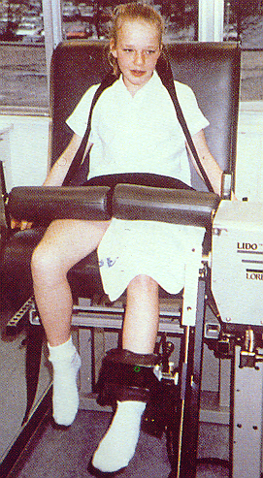
Type of exercise
Isokinetic exercise:
  Exercise with movement controlled so that it occurs throughout a range at a constant angular velocity as the muscle shortens or lengthens but the load may be variable

Slide 35
Exercise goals
To increase muscle strength
To increase muscle endurance
To increase speed
To improve cardiovascular fitness
To improve flexibility
To improve control and coordination

Slide 36
MUSCLE STRENGTH AND ENDURANCE
STRENGTH: ability of the muscle to generate force against some resistance
ENDURANCE: ability to perform repetitive muscle contraction against some resistance of an extended period of time
POWER: large amount of force generated quickly; includes elements of strength and speed

Slide 37
CLOSED KINETIC CHAIN EXERCISES
ADV: safer and produce stresses and forces that are potentially less of a threat to healing structures
e.g. mini squats - 0 - 40 degrees
  leg press
  stair climbing
  lateral step up
  push ups , chin ups
  hand stands
  weight shifting exercises using medicine balls

Slide 38
CARDIOVASCULAR ENDURANCE
CONTINUOUS TRAINING
  imposes submaximal energy requirement that is consistent throughout the training session
  e.g. aerobic/ rhythmic walking, jogging, rowing, cycling, swimming

Slide 39
Cardiovascular endurance
INTERVAL TRAINING
  uses a series of exercise stations that consists of various combinations of weight training, flexibility, calisthenics, brief aerobic exercises

Slide 40
CARDIOVASCULAR ENDURANCE
CIRCUIT TRAINING
  followed by relief stations incorporates work intervals
FARTLEKTRAINING
  types of cross country running, means speed play, similar to interval training

Slide 41
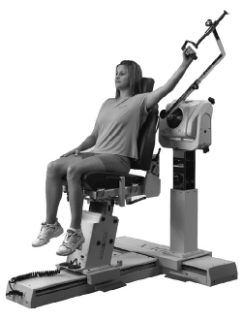
PLYOMETRIC EXERCISES:
exercises that encompasses a rapid stretching of muscle eccentrically, followed by a rapid concentric contraction
the greater the stretch before concentric contraction, the greater the resistance the muscle can overcome
emphasize the speed of the eccentric phase of rate of stretch is more critical than the magnitude of the stretch

Slide 42
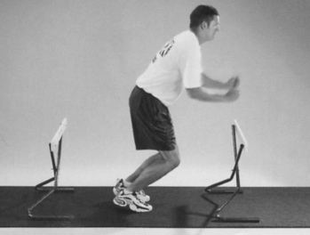
Plyometric exercises
ADV: control in dynamic movements
DISADV: put more stress on the MS system, must be technically correct and specific to one’s age, activity and physical and skills devt.

Slide 43
TRAINING PERIODIZATION
MACROCYCLE - yearly ( 1 - 4)
MESOCYCLE - months
MICROCYCLE - weekly
PREPARATION PERIOD ( pre season)
TRANSITION PERIOD (basic strength phase)
COMPETITION PERIOD ( strength and power phase)
TRANSITION PERIOD ( peak or maintenance phase)
ACTIVE REST ( off season )

Slide 44
PREREQUISITES FOR PLYOMETRICS
DYNAMIC
  VERTICAL/ SINGLE LEG JUMP
  LONG JUMP EQUAL TO HEIGHT
STATIC
  single leg stance
  single leg 25% squat
  single leg 50% squat
  UPPER EXTREMITY THERABALL TOSS

Slide 45
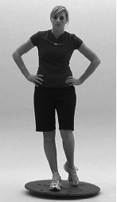
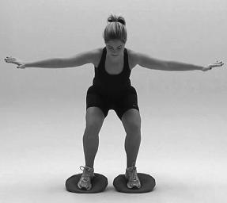
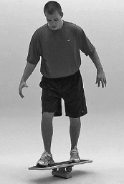

Slide 46
CATEGORIES OF PLYOMETRICS
IN PLACE JUMPING
STANDING JUMPING
MULTIPLE RESPONSE JUMPS AND HOPS
IN DEPTH JUMPING AND BOX DRILLS
BOUNDING
HIGH STRESS AND SPECIFIC SKILLS

Slide 47
Prescription - Intensity
Classification of intensity | Training Heart Rate (THR)
Very light | <30 %
Light | 30-49 %
Moderate | 50-74 %
Heavy | 75-84 %
Very Heavy | >85 %
HR_{MAX} = 208-0.7 * Age
THR= RHR + HR reserve
Hr reserve = HR_{MAX} -RHR
Notes:
47
Moderate to vigorous physical activity on a daily basis is consistent with desired health and behavioral outcomes. METs (metabolic equivalents for specific activities on the basis of the ratio of activity to resting energy expenditure).
Because exercise energy expenditure per unit of body mass is higher in children and adolescents than in adults, these MET values have limitations. Moderate-to-vigorous activities require about 5 to 8 METs, and such intensity is needed to derive most health benefits. A person who is active at a light intensity level should be able to sing while doing the activity. One who is active at a moderate intensity level should be able to carry on a conversation comfortably while engaging in the activity. If a person becomes winded or too out of breath to carry on a conversation, the activity can be considered vigorous.

Slide 48
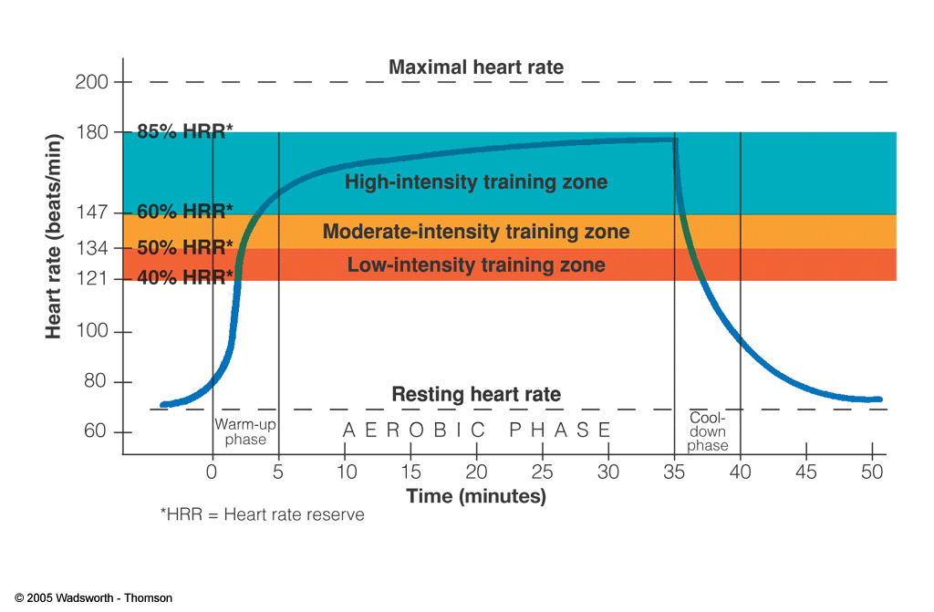
Typical Aerobic Exercise session

Slide 49
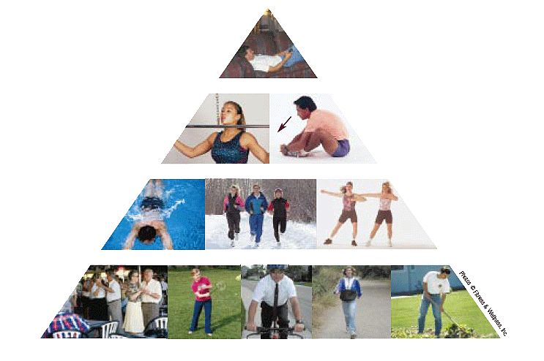
Physical Activity Pyramid
Minimize inactivity
Strength and Flexibility: 2–3 days/week
Cardiorespiratory endurance: Exercise 20–60 minutes 3–5 days/week
Physical activity: Accumulate 60 minutes nearly every day

Slide 50
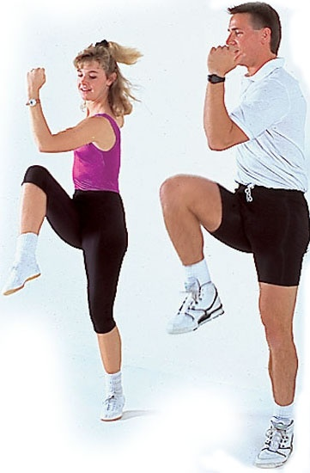
THANK YOU VERY MUCH

